Slide 1
Ticket Booking Analysis
British Airways

Slide 2
Analysis
Data of 50,000 was analyzed to develop a model that can predict ticket booking.
Key factors analyzed:
num_passengers = number of passengers travelling
sales_channel = sales channel booking was made on
trip_type = trip Type (Round Trip, One Way, Circle Trip)
purchase_lead = number of days between travel date and booking date
length_of_stay = number of days spent at destination
flight_hour = hour of flight departure
flight_day = day of week of flight departure
route = origin -> destination flight route
booking_origin = country from where booking was made
wants_extra_baggage = if the customer wanted extra baggage in the booking
wants_preferred_seat = if the customer wanted a preferred seat in the booking
wants_in_flight_meals = if the customer wanted in-flight meals in the booking
flight_duration = total duration of flight (in hours)
booking_complete = flag indicating if the customer completed the booking

Slide 3
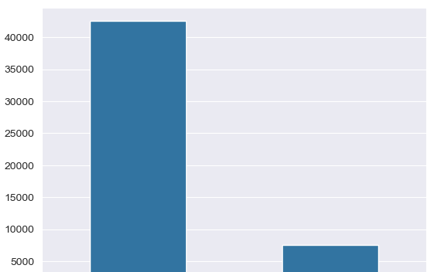
Majority of passengers do not book their tickets pre flight.

Slide 4
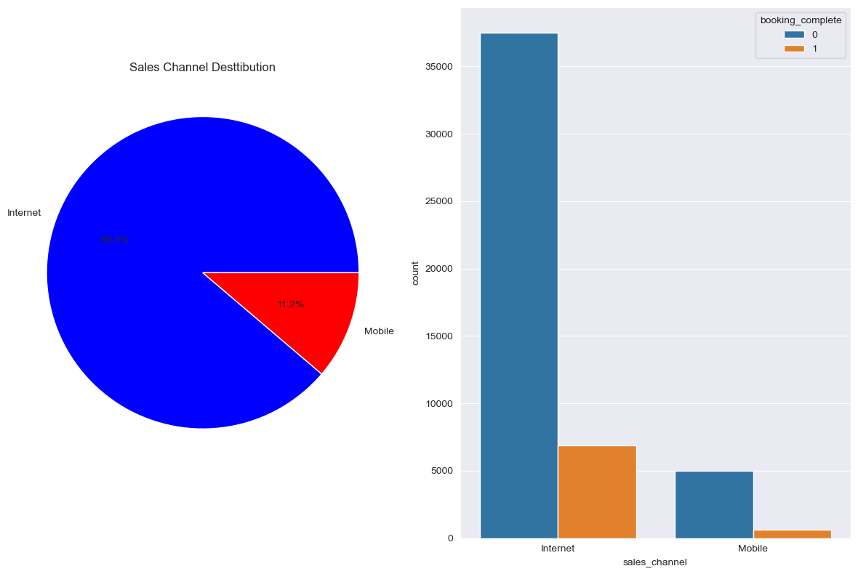

Slide 5
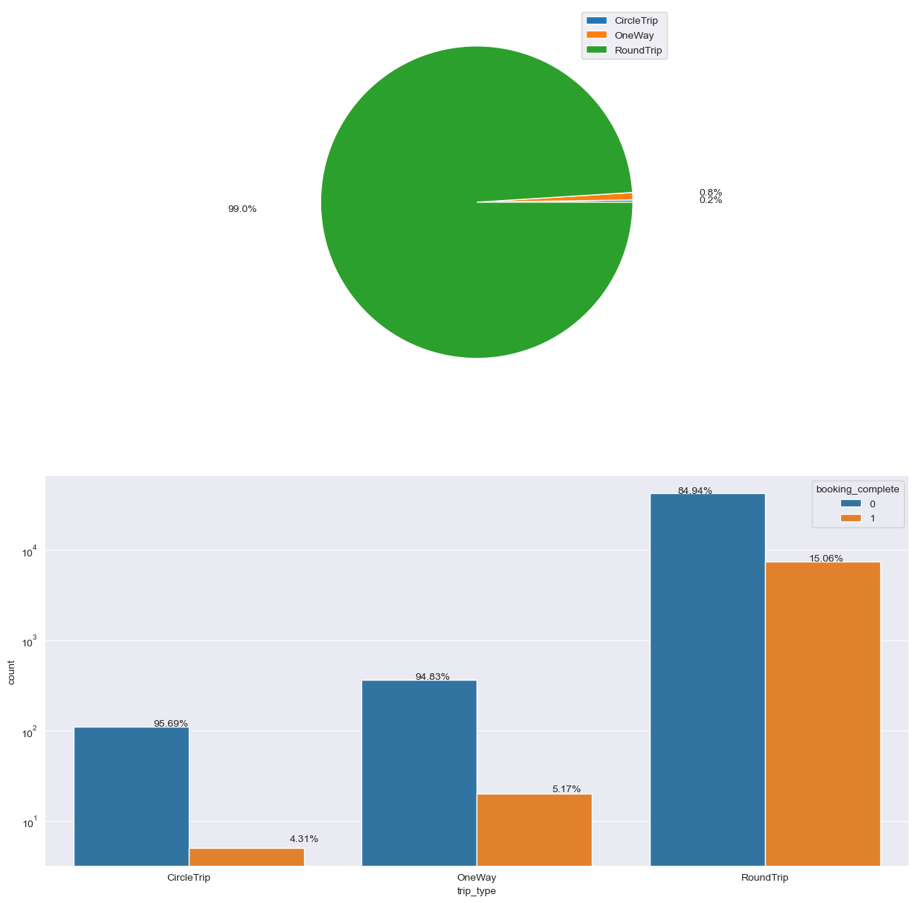

Slide 6
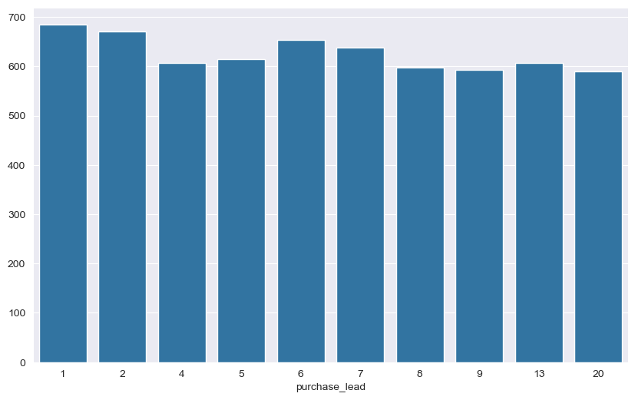

Slide 7
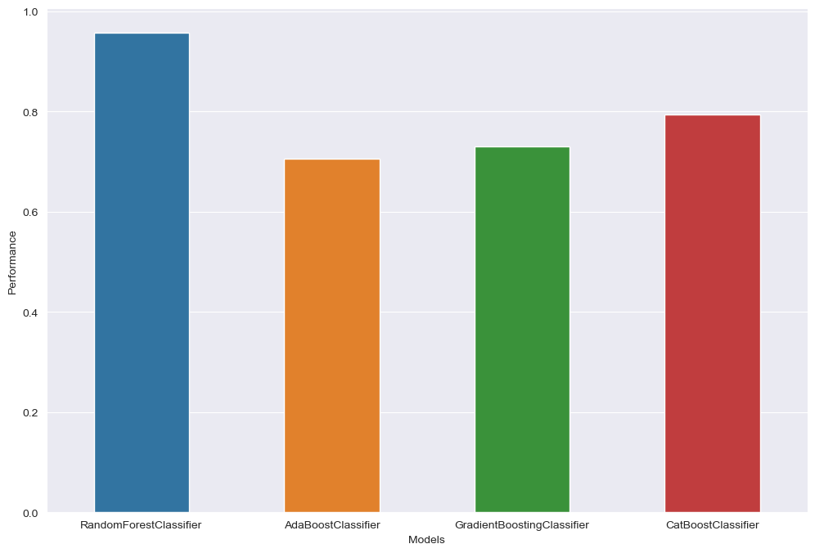
We train multiple classification model to our initial data which had been divided in to training and testing set.
We observed that RandomForestClassifier model performed the best among others with a f1 score of 0.96.

